Slide 1
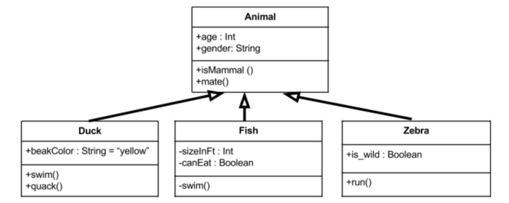

Class Diagrams

Slide 2

Class Diagrams Tutorial

Slide 3
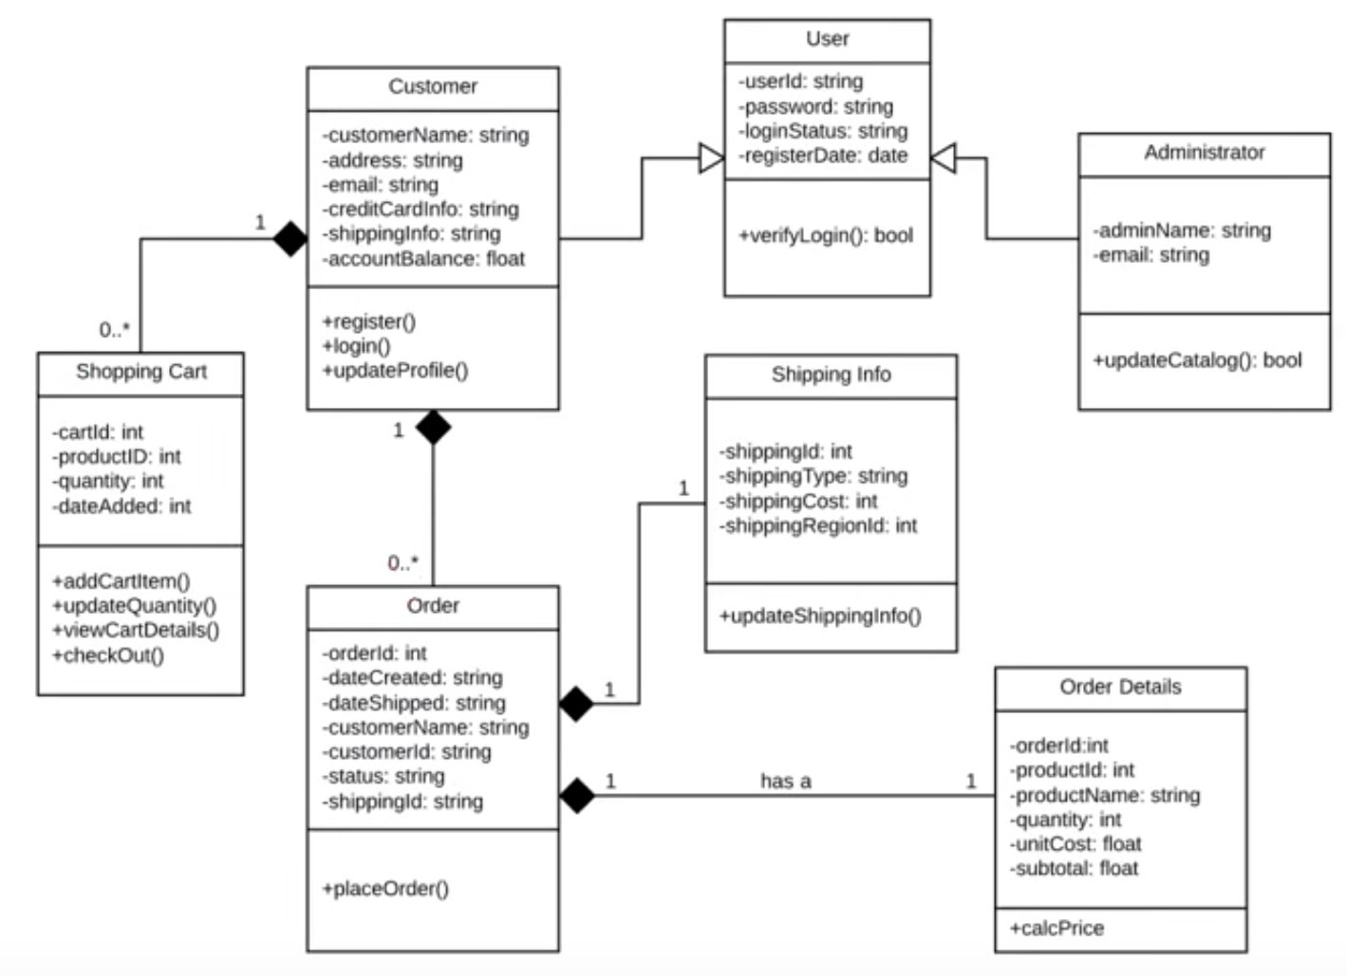
Example for UML Class Diagram

Slide 4
Why do we need class diagrams?
Planning and modeling makes programming much easier.
Making changes to class diagrams is easy.
Changing code can be expensive /difficult / dangerous (?).
You don’t need much technical / language-specific knowledge to understand it.
Notes:
Not dangerous if you have proper unit tests!

Slide 5

Think of building a house …
You wouldn’t just grab a hammer and get to work.
You need to have a design plan.
So you can ANALYZE & MODIFY the system easily.

Slide 6
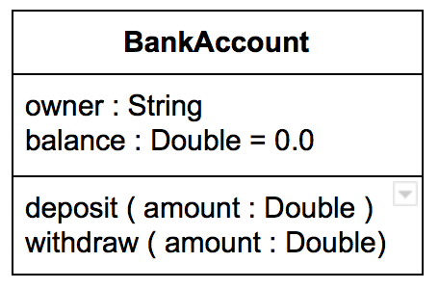
Class Representation in UML
Box with 3 compartments
Class name
Class attributes
Class methods
Conventions
attribute name : type
method name(parameter: type)
You can set a default value
balance : Double = 0

Slide 7

Access level modifiers
Java Modifier | UML Symbol | Accessible in same class | Accessible in same package | Accessible in subclass | Accessible in every package
public | + | Yes | Yes | Yes | Yes
protected | # | Yes | Yes | Yes | No
no modifier (“package-private”) | ~ | Yes | Yes | No | No
private | - | Yes | No | No | No
Protected class members are also accessible in subclasses, which are not part of the same package!

Slide 8
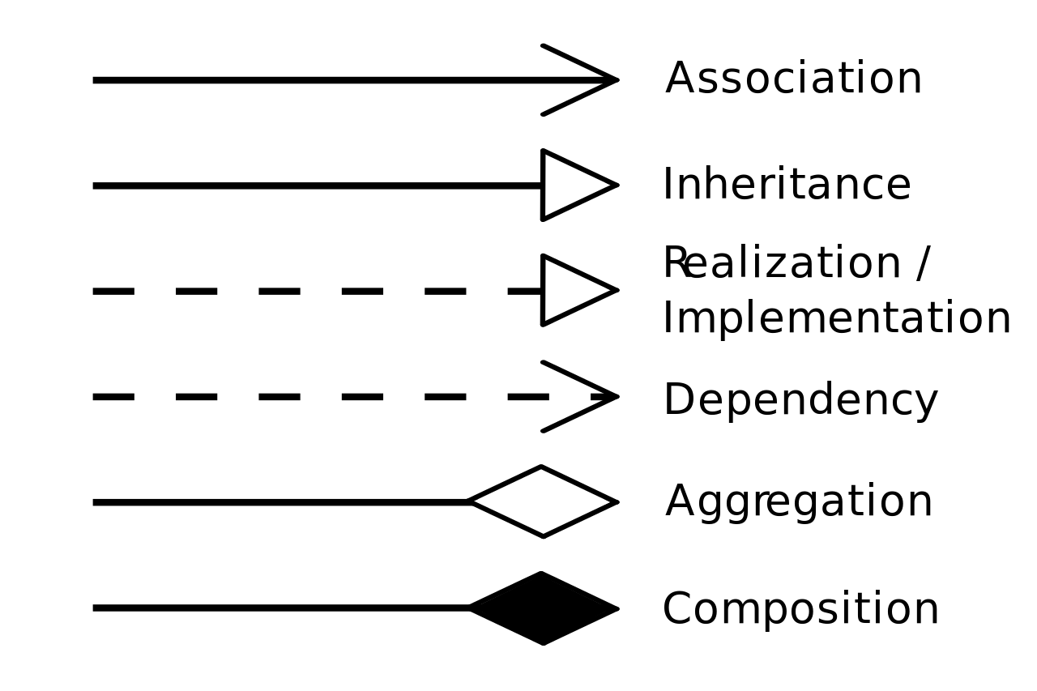
Relationships between Classes

Slide 9
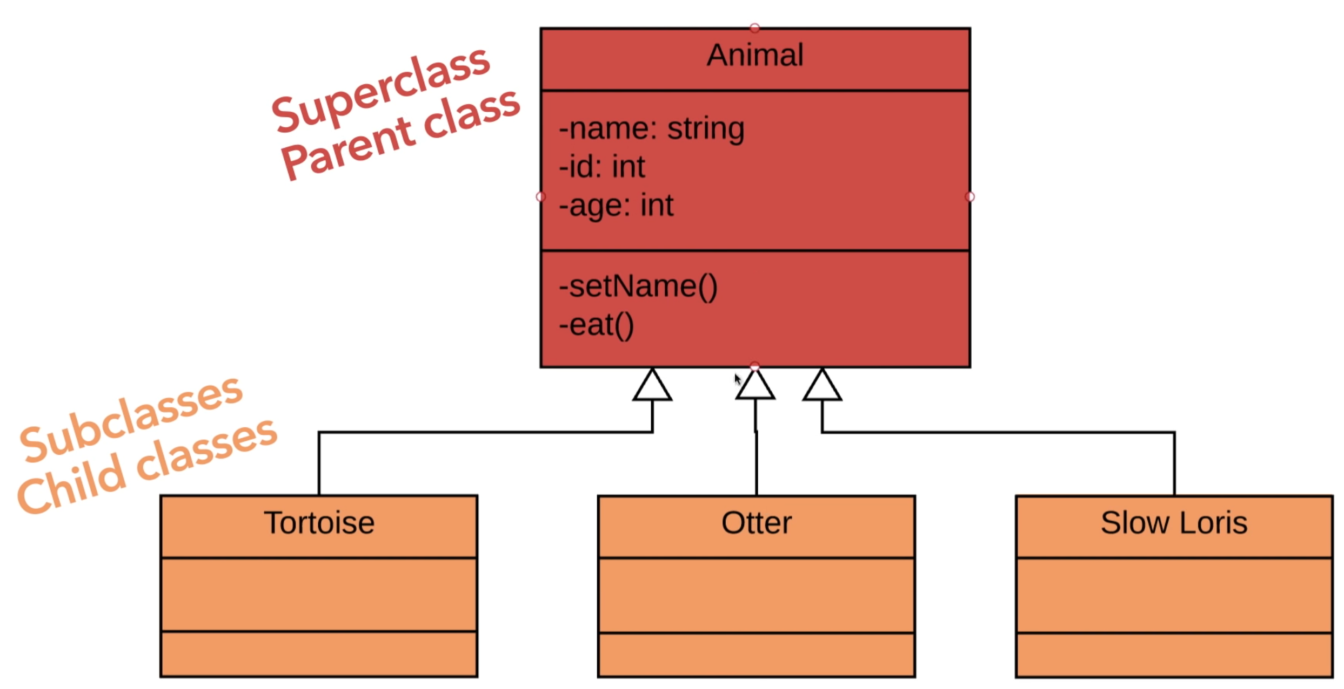
Inheritance

Slide 10
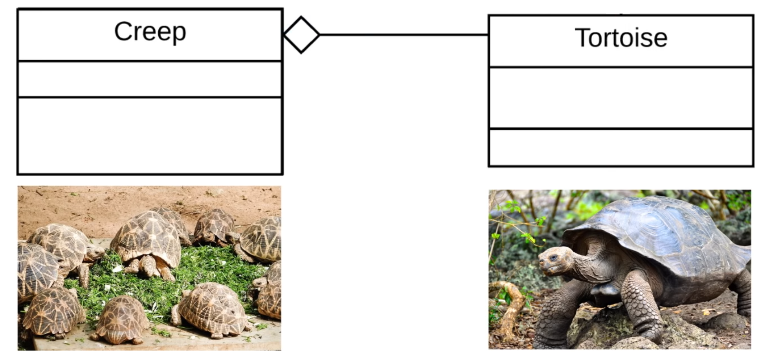
Aggregation
The tortoise can exist without the creep!

Slide 11
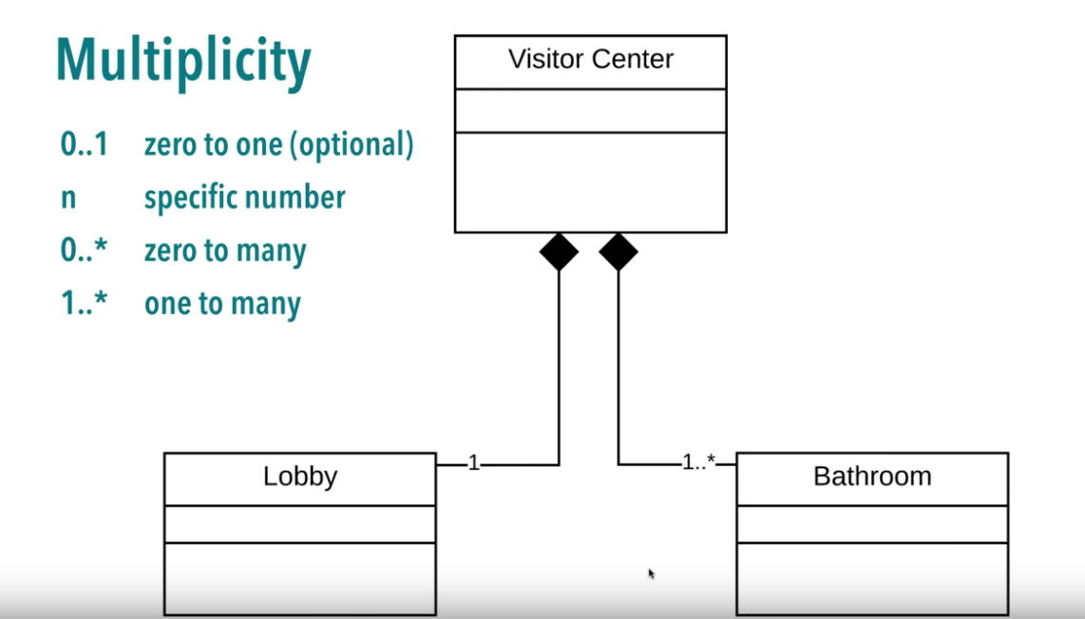
Composition (with Multiplicity)
The bathroom can’t exist without the visitor center!

Slide 12
Class Diagram for Online Shopping Cart

Slide 13
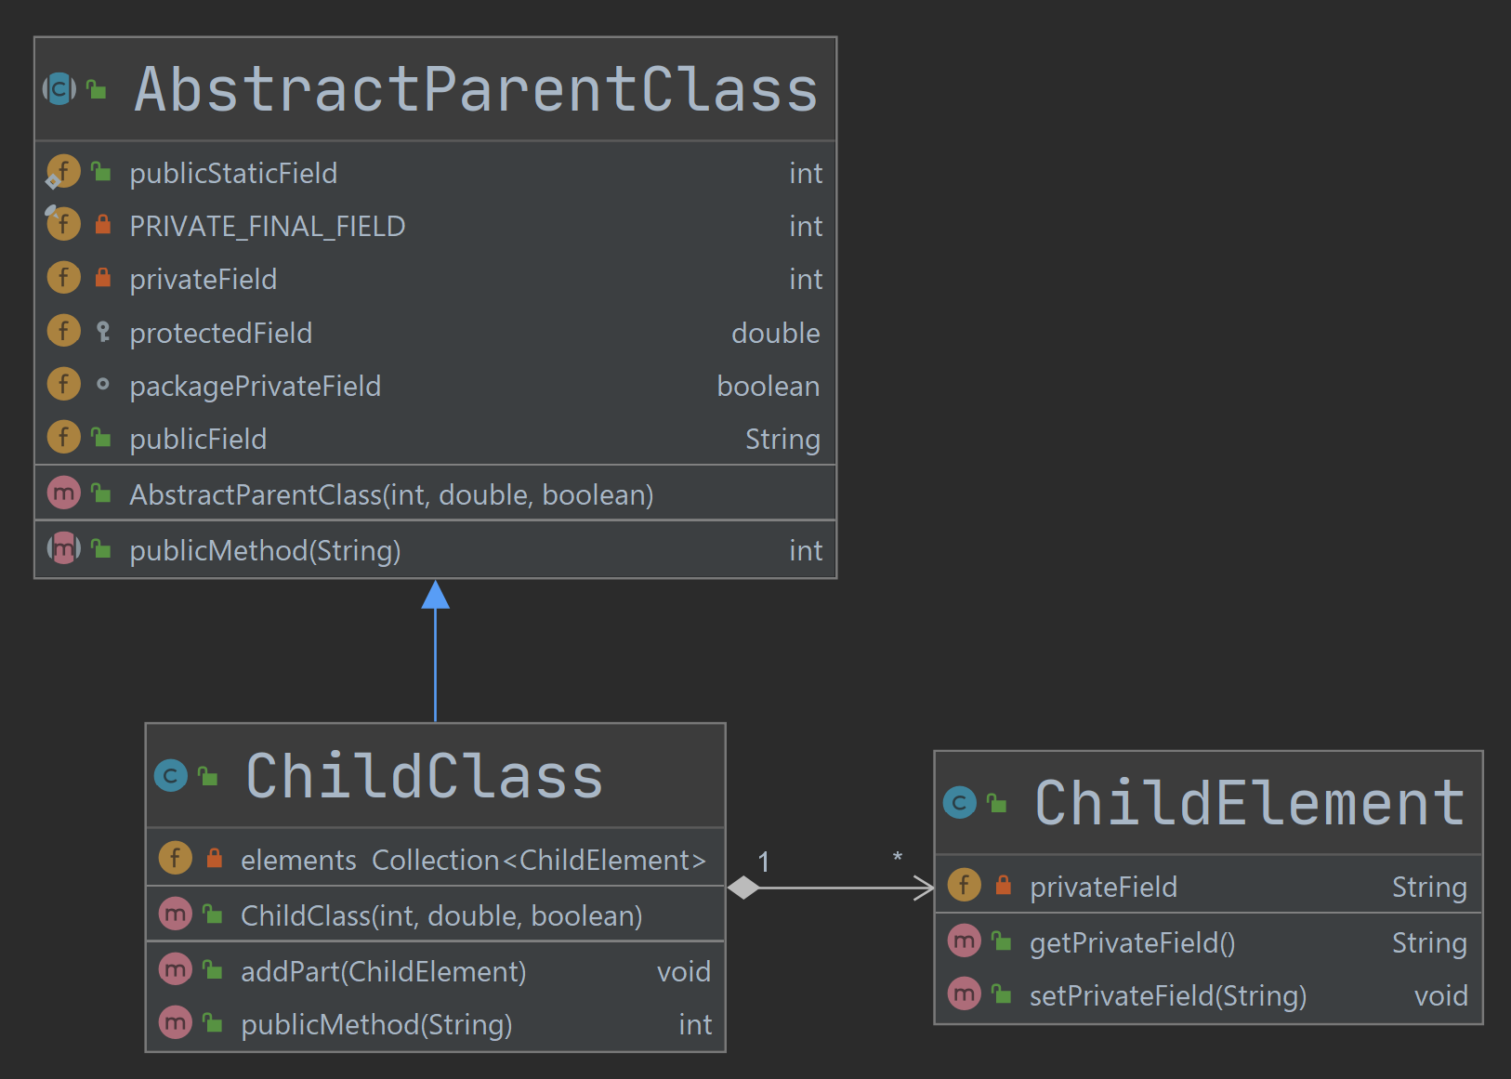
Class Diagrams in IntelliJ IDEA
How to create a diagram
Right-click a package in Project tool window
Select Diagrams | Show Diagram
Select Java Class Diagram
Symbols look a little bit different (learn them!!!)
Associations are always shown as compositions. :-(
https://www.jetbrains.com/help/idea/class-diagram.html

Slide 14
Resources
https://medium.com/@smagid_allThings/uml-class-diagrams-tutorial-step-by-step-520fd83b300b
https://www.youtube.com/watch?v=UI6lqHOVHic&t=14s

